Slide 1
The multi-demand networks contribute to math academic performance
Team members: Tongxi YANG, Yixuan SUN, Rui GUO
Notes:
Good evening everyone! We are so happy to share our team work with you. I am YANG tongxi, I’m sun…
Our research focus on the networks related to math academic performance.

Slide 2
01.
Introduction
CONTENTS
02.
Methods and Results
03.
Discussion
Notes:
Today, we will introduce our work from 3 parts, introduction, methods and results, last some discussion;

Slide 3
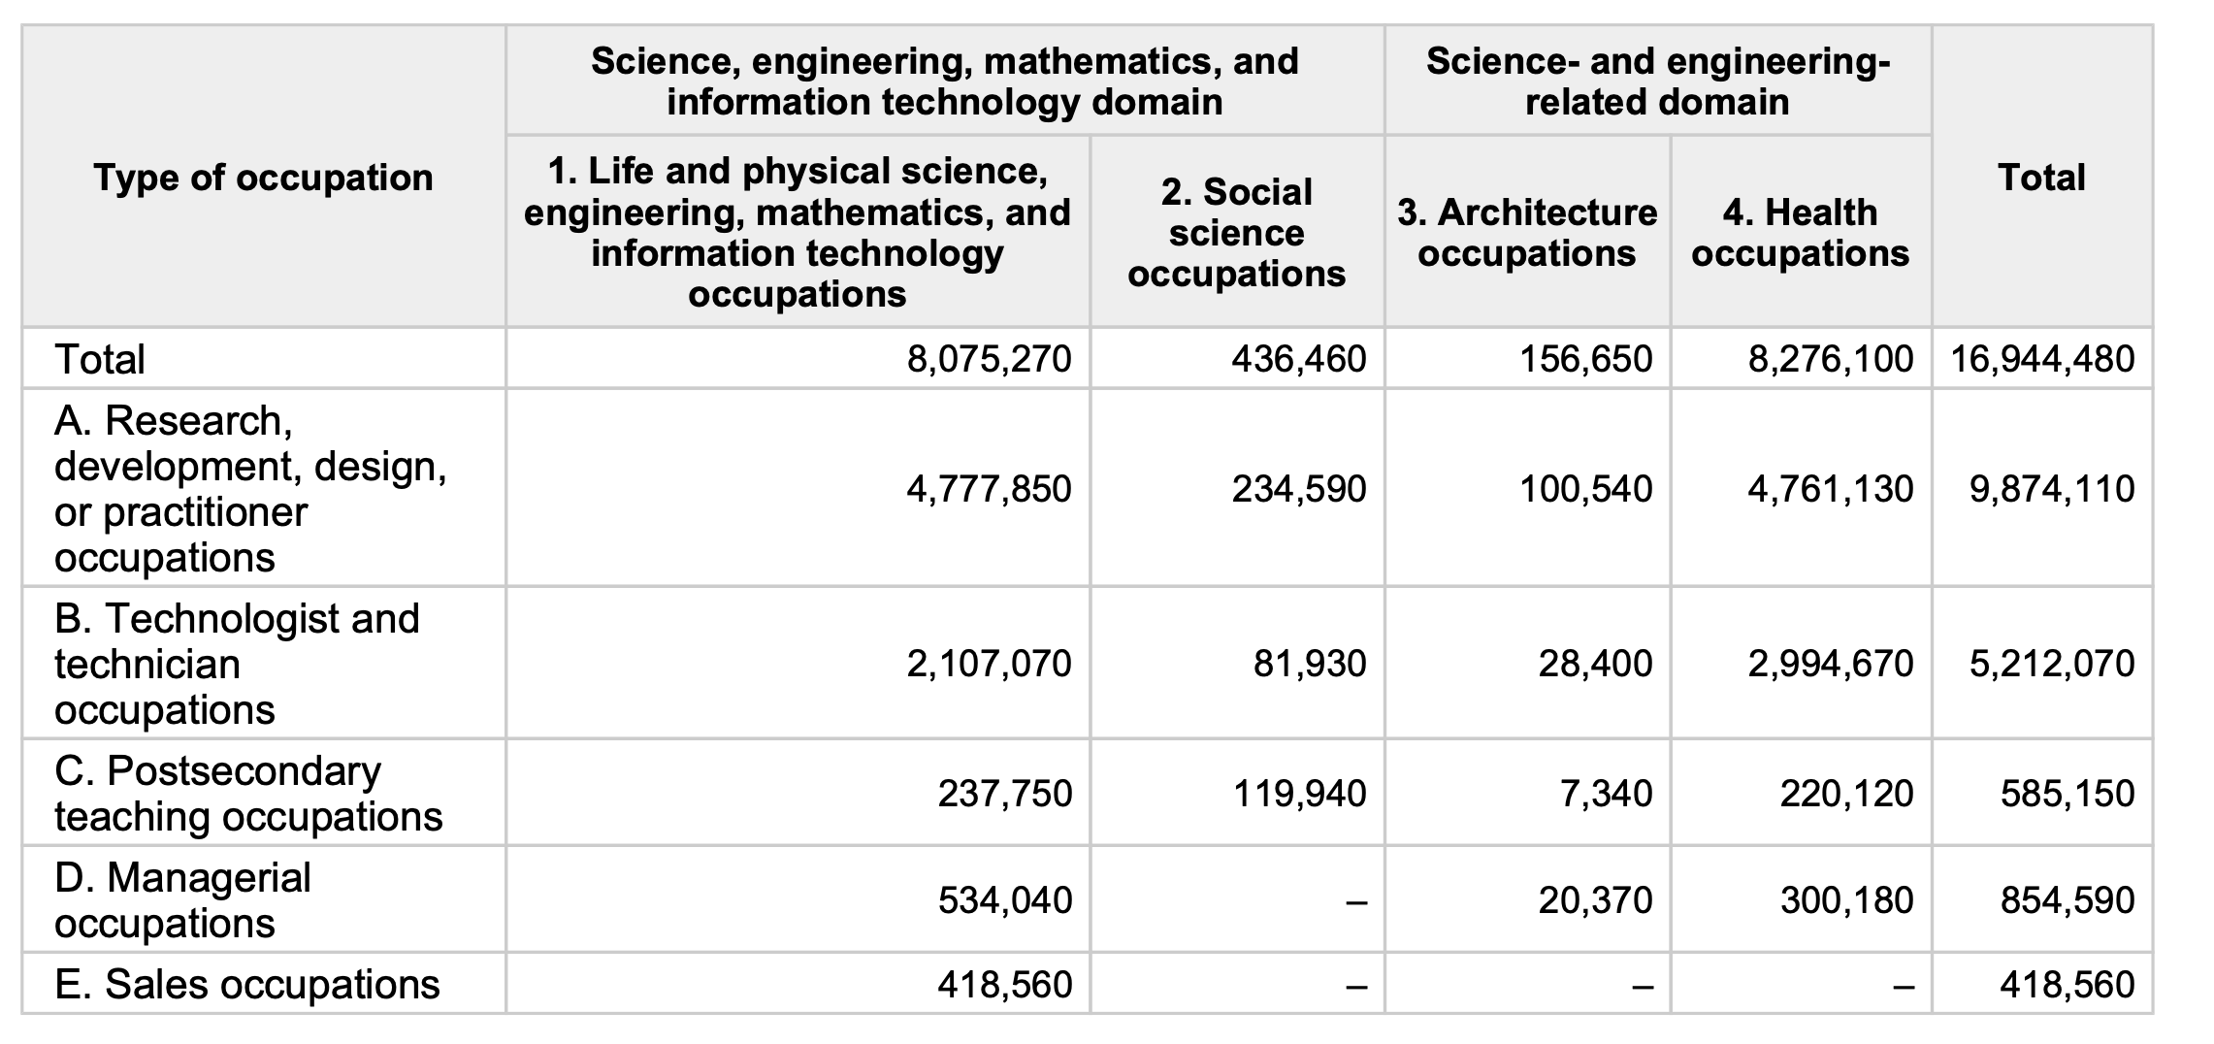
survey:
Q1: How many of you think you are good at math? Please raise your hands.
Q2: Why did you choose the department of Applied Mathematics
An overview of employment and wages in science, technology, engineering, and math (STEM) groups
Notes:
Before introduction, we want to conduct a survey first.
We are wondering that How many of you think you are good at math? Please raise your hands.（It seems that everyone is very modest.）
Why did you choose the department of Applied Mathematics?
3. What strategies do you use when studying for math exams?
Thank you so much for your answers! now Let’s start our introduction.

Slide 4
01.
Introduction

Slide 5


Question:
AMA505
Q1: How to improve math scores by not just doing exercises?
AMA563
AMA541
AMA…
Q2: Do brain networks differ between people with high math scores and those with lower math scores?
Notes:
As we all know, mathematics is one of the basic subjects of education, it is not only important to social development, but also the foundation of modern science. A lot of studies have shown that even if economic factors are excluded, math ability will still affect individual employment, salary. So congratulations everyone, we have chosen a good department！
However，in math education, we see huge differences between individuals. Some kids are naturally gifted in math, while others struggle with it.
Many people mentioned that they would prepare for math exams by doing exercises. Have you ever thought about whether we can use other methods to assist our math learning, and why some people are very talented in math. How can we learn mathematics efficiently and flexibly?
We are very curious about these two questions, so our study also attempts to answer them.

Slide 6
Literature review
Cognitive mechanism of mathematics learning: multiple cognitive abilities
In the past few decades, cognitive neuroscience research on mathematics has mostly focused on the impact of a single cognitive task.
Studies have shown that working memory is related to the conceptual understanding and problem-solving process of mathematical learning. (Menon , 2016; Swanson, 2011).
Attention also has a significant impact on academic performance in mathematics, and this effect persists even after controlling for working memory .(Swanson, 2011).
Mathematics learning is also related to individual risk-taking behavior. Individuals with risk-taking tendencies will be more proactive in challenging more difficult content in the process of mathematics learning (Erbas & Bas,2015).
The primary school stage is also a stage of rapid development of individual cognitive and emotional abilities, it is necessary to explore the impact of cognitive and emotional development on mathematics learning (Hao et al., 2021).
However, mathematics learning involves multiple cognitive and emotional factors and requires the integration of multiple cognitive abilities, not just a single one.
Notes:
After summarizing the literature, we found that previous research on mathematics has mostly focused on the impact of a single cognitive task.
Then, from our own experience of learning, We believe It’s definitely not only related to just a single task, for example, we need to concentrate when listening to the class, have some courage to solve difficult problems, etc.

Slide 7
Literature review
Neural Mechanisms of Mathematical Learning： multi-demand brain networks
The multi-demand system is a group of brain regions that are commonly used in situations of high cognitive challenges, mainly including the lateral frontal lobe from the frontal gyrus to the premotor cortex, the parietal lobe, the anterior insula, the supplementary motor cortex, and part of the cerebellum (Duncan, 2010, 2013).
Cognitive mechanism of the multi-demand brain network is consistent with the needs of mathematical learning
research shows that an individual‘s fluid intelligence level is significantly related to mathematics achievement, often involve parts of the frontal and parietal lobes of the brain. (Desco et al., 2011).
humans can acquire the ability to perform symbolic calculations in just a few years of learning in early childhood, but monkeys cannot achieve significant practice effects after years of training, but monkeys have not developed the prefrontal cortex needed for this connection(Cantlon, 2012).
However, previous studies on multi-demand brain networks have focused on speech understanding (Blank et al., 2014; Diachek et al., 2020). Research by Evgeniia (2020) shows that multi-demand brain networks are not involved in the core part of speech understanding. This reminds us of Almaric’s series of studies on brain networks specific to mathematical knowledge (Amalric & Dehaene, 2016, 2018, 2019).
Notes:
The multi-demand system assist humans in task decomposition, involving regions like the FPN, anterior insula, motor cortex, and part of the cerebellum. When solving math problems, we represent the problem, list the correct formula, and calculate, you know, step by step, which involves task decomposition. Thus, the cognitive mechanism of the multi-demand brain network are consistent well with mathematics learning.
However，most studies on multi-demand brain networks have looked at speech understanding, research on these networks relate to math achievement is not clear.

Slide 8
Literature review summary:
Researchers focus more on the impact of a single cognitive factor on mathematics learning.
However, mathematics learning is a high-level human cognitive activity, the cognitive mechanism between multitask and mathematical learning is insufficient.
Cognitive mechanism of the multi-demand brain network is consistent with the needs of mathematical learning.
However, previous research on the relationship between multiple demand systems and mathematics achievement is still unclear.
Therefore, we explore the relationship between multiple tasks and mathematics performance and understand this from the perspective of multi-demand networks.
Study1: the relationship between multiple tasks and mathematics performance
H0: there is no relationship
Study2: differences in the multi-demand networks of people with good math scores and those with relatively poor math scores
H0: there is no differences
Notes:
So quick summary of the literature review:
We found those two gaps related to our questions. Therefore, we want to solve them，We divide our questions into two studies, which we will address later.

Slide 9
Data introduction
Beijing section of the Children's School Functions and Brain Development Project (CBD).
Participants：
310 school-age children (6-12 years old), including 147 boys and 163 girls.
three units: Peking University, Beijing Normal University, and Huilongguan Hospital.
All subjects had no visual impairment after screening and recalibration, and had no history of any neurological or psychiatric diseases, and no medication experience during the study. The child subjects and their parents have been informed of the experimental process and signed the informed consent form in writing.
Academic math Achievement Test:
3 aspects: numbers and algebra, space and graphics, statistics and probability.
4 abilities: knowing facts, applying rules, mathematical reasoning, and solving unconventional problems.
2 stages: Grades 1-3 and grades 4-6
Mathematics scores are standardized within the academic period.
Notes:
To address our problems, we selected a unique dataset with four tasks. Our data from Beijing section of the CBD project.
All children finished one academic math achievement test.

Slide 10
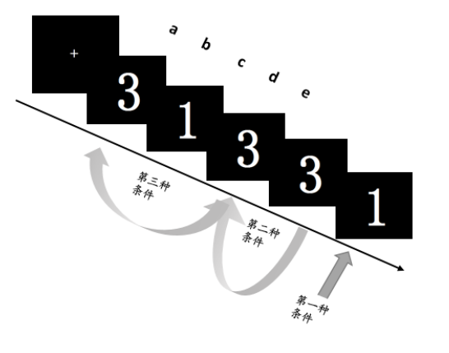
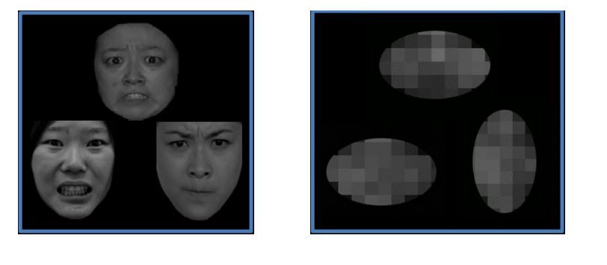
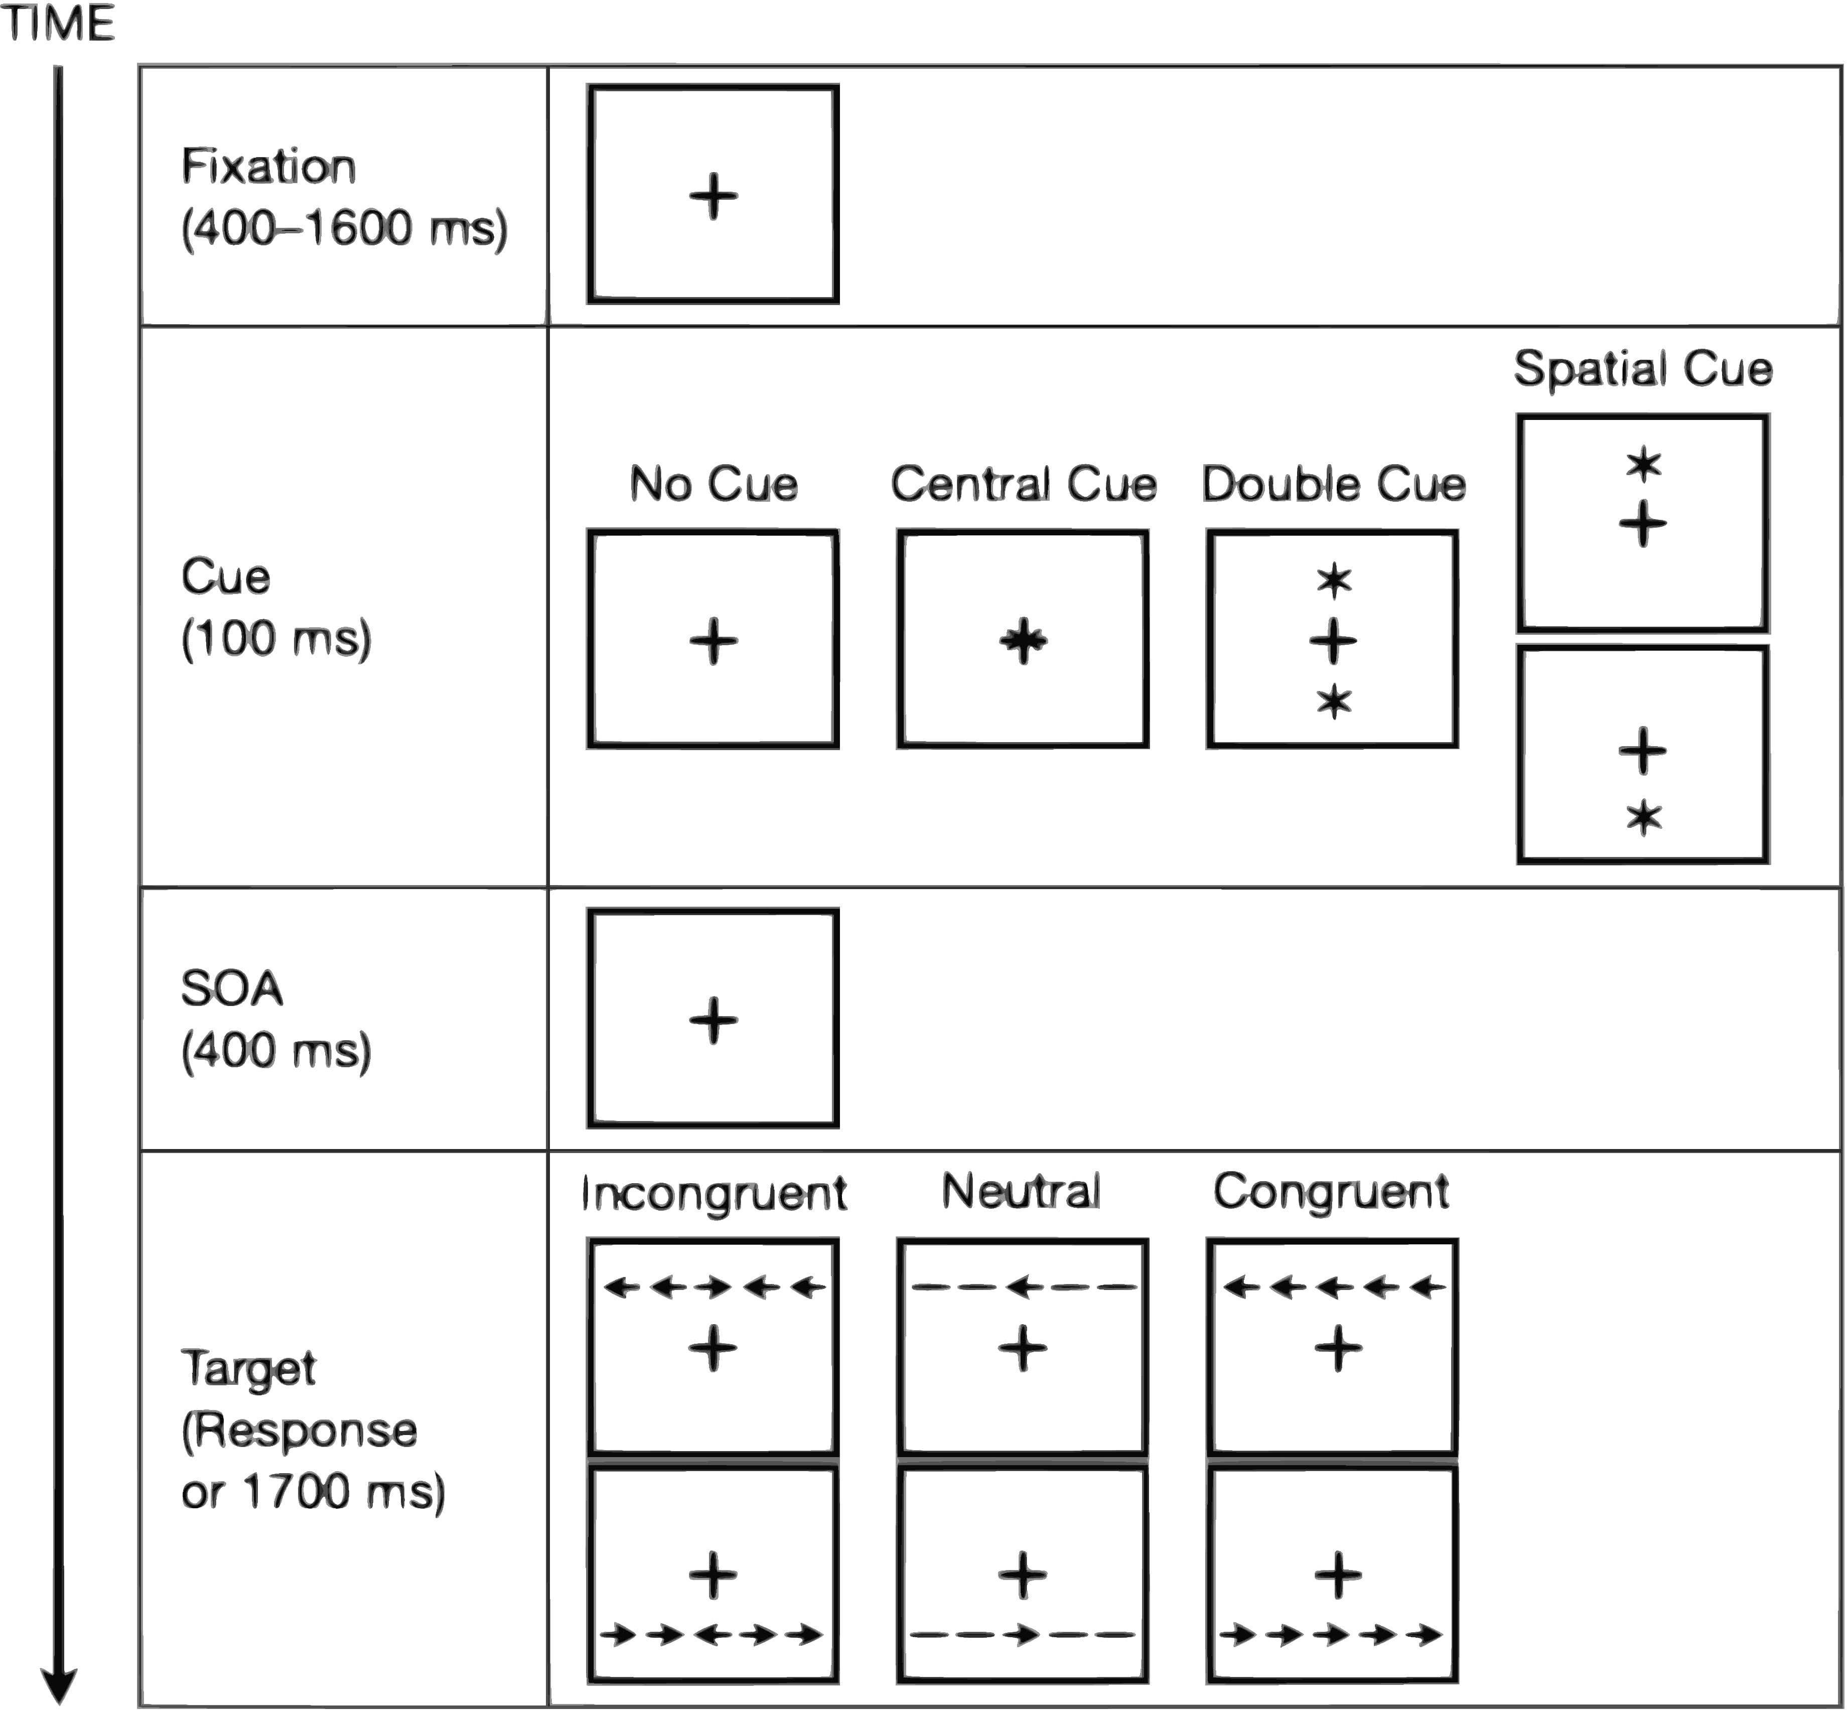
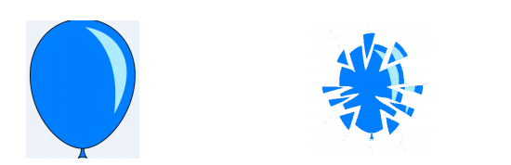
Tasks introduction
Working memory: N-back task
Emotion recognition: Emotion Face Matching task
Attention ability: Attention Network Test
Risk decision-making: Balloon Analogue Risk Task
Notes:
The MRI data collection involves four tasks, each measuring a different ability. Working memory is checked with the N-back task, emotion recognition with the Emotion Face Matching task, attention with the Attention Network Test, and risk decision-making with the Balloon Analogue Risk Task. We won't go into details due to time constraints.
Working memory is assessed using the N-back task, which measures an individual's working memory ability by controlling different working memory load conditions. The task consists of three different workload conditions (0-back, 1-back, and 2-back), each condition consisting of 4 blocks, for a total of 12 blocks. In each block, the subject first sees a prompt about the current block (0-back, 1-back, and 2-back) for 2 seconds. Then a sequence of 15 random numbers is presented, each of which is displayed for 400 milliseconds. In the case of 0-back, the subject needs to respond to the number "1" by pressing the key. In the condition of 1-back, the subject needs to respond to the number that is the same as the previous number. In the condition of 2-back, the subject needs to respond to the number that is the same as the two previous numbers.
The experimental paradigm of emotion recognition uses the Emotion Face Matching task, which consists of an emotion condition and a control condition. Each condition contains 5 blocks, and each block contains 6 trials. In each block, the subject first sees a prompt about the current block (emotion matching/graphic matching), indicating whether the next task is to identify facial emotions or graphic directions. The prompt is presented for 5 seconds. In each block, 6 trials are presented one by one, each trial is presented for 5 seconds. The subject needs to choose the stimulus with the same emotion or graphic direction as the target stimulus from the two stimuli.
The experimental paradigm of attention ability adopts the Attention Network Test, which consists of a cue presentation phase (no cue, double cue, spatial position cue and center cue) and a flanker task phase (consistent and inconsistent), with a total of six different trials. Because the task lasts for a long time, it is divided into two phases, each including 96 trials. At the beginning of each trial, the subject first sees a fixation point, which lasts between 400 and 1000 milliseconds. Then the cue will be presented for 150 milliseconds. The clues are divided into: (1) no cue; (2) double cue: two asterisks appear in the upper and lower positions; 3) spatial cue: one asterisk appears in the upper or lower position; (4) center cue: one asterisk appears in the center position. Then a fixation point is presented again for 450 milliseconds. Next, the subject will see a row of small fish and needs to judge the direction of the fish in the middle position. The directions of the surrounding non-target small fish and the target small fish may be consistent or inconsistent, which constitutes the two conditions of the flanker condition. Feedback will be presented after 999 milliseconds. If the subject responds correctly, the fish in the middle position will spit bubbles.
The experimental paradigm of risk decision-making uses the Balloon Analogue Risk Task, which simulates the decision-making process of risk situations in real life by inflating a balloon. In each trial, the subject needs to press a button to inflate the balloon (key 1) or stop inflating (key 2). Each time the balloon is inflated, it expands a little bit, and the subject's reward increases by 1 yuan. The larger the balloon, the greater the possibility of explosion. If it exceeds the preset maximum value, it will explode. If the subject does not respond for a long time (3 seconds), the balloon will also explode, and the reward obtained in this round will be cleared. The subject needs to obtain the maximum benefit by inflating and stopping inflating at the appropriate time. The stage of choosing whether to inflate is the "reward-risk trade-off" condition, the interface of reward feedback that appears after the subject decides to stop inflating is the "reward processing" condition, and the interface of balloon explosion is the "risk processing" condition.

Slide 11
02.
Methods and Results
Notes:
Next， our methods and results

Slide 12
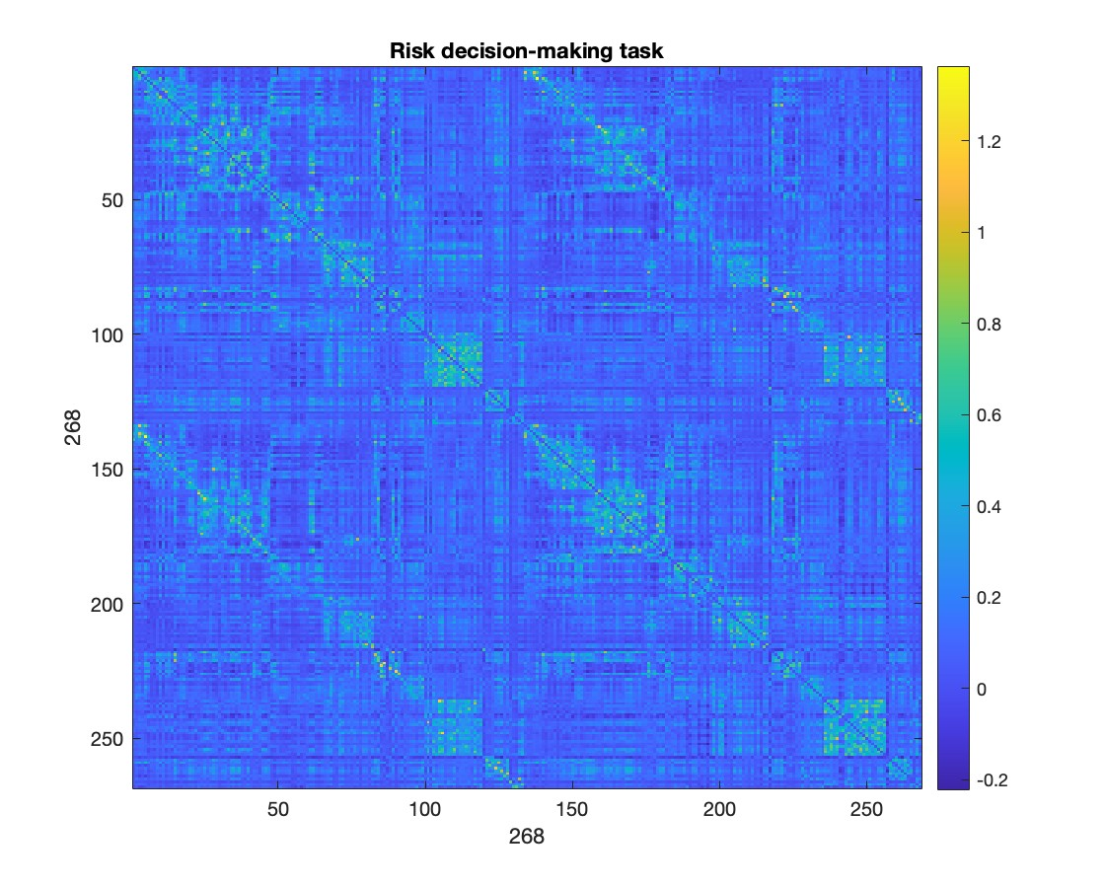
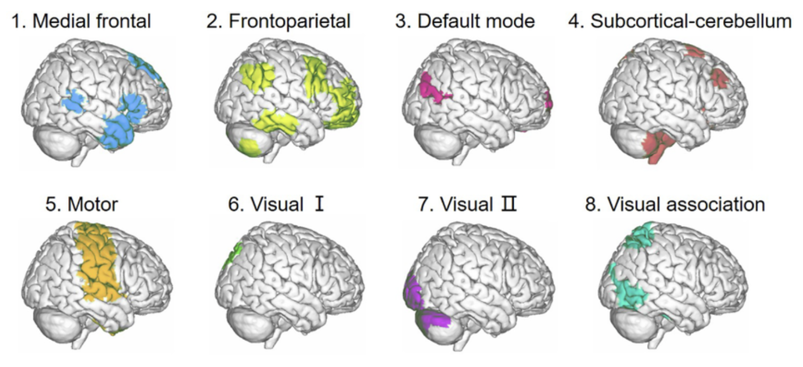
Overall Workflow
1. Data Preprocessing
2. ROI extraction
3. FC calculation
4. Model
Start
Study1:
1）Separate 4 tasks (ROIs)
2）Combine 4 tasks(Networks)
For each participant, calculate Pearson correlation between regions for 4 tasks
fMRIPrep21.4.1
Regress 24 columns of head motion
Study2:
networks difference test
Time-align and image deformation
R square
MSE
Use Shen 268 template to extract the average BOLD signal of all voxels in the regions of interest (ROI)
standardized to the standard spatial template(MNI)
End
Process noise with ICA-AROMA
Map 268*268 ROI into 8 networks
Notes:
First, let’s have a look of our overall workflow:
All MRI data were processed using the same standard with fMRIPrep1.4.1.
We use Shen template to extract the average BOLD signal of all voxels in ROI, the Pearson correlation between regions was calculated. And we map 268 ROIs to 8 networks. In the first study, we modeled the four tasks at the ROI level and then merged 4 tasks at the network level. In the second study, we conducted network-level test.
The Shen 268 template includes the cerebral cortex, subcutaneous tissue, and cerebellum.
the average signals of white matter and cerebrospinal fluid in the preprocessing output results, and
The image sequence was then time-aligned and the image deformation was adjusted according to the field map. Finally, the task image was registered with the structural image and further standardized to the standard spatial template (Montreal Neurological Institute, MNI). After smoothing with a Gaussian kernel with a full-width half-maximum (FWHM) of 6 mm, the noise was further processed using ICA-based Automatic Removal of Motion Artifacts (ICA-AROMA), and the average signal of white matter and cerebrospinal fluid and various head motion parameters were output.

Slide 13
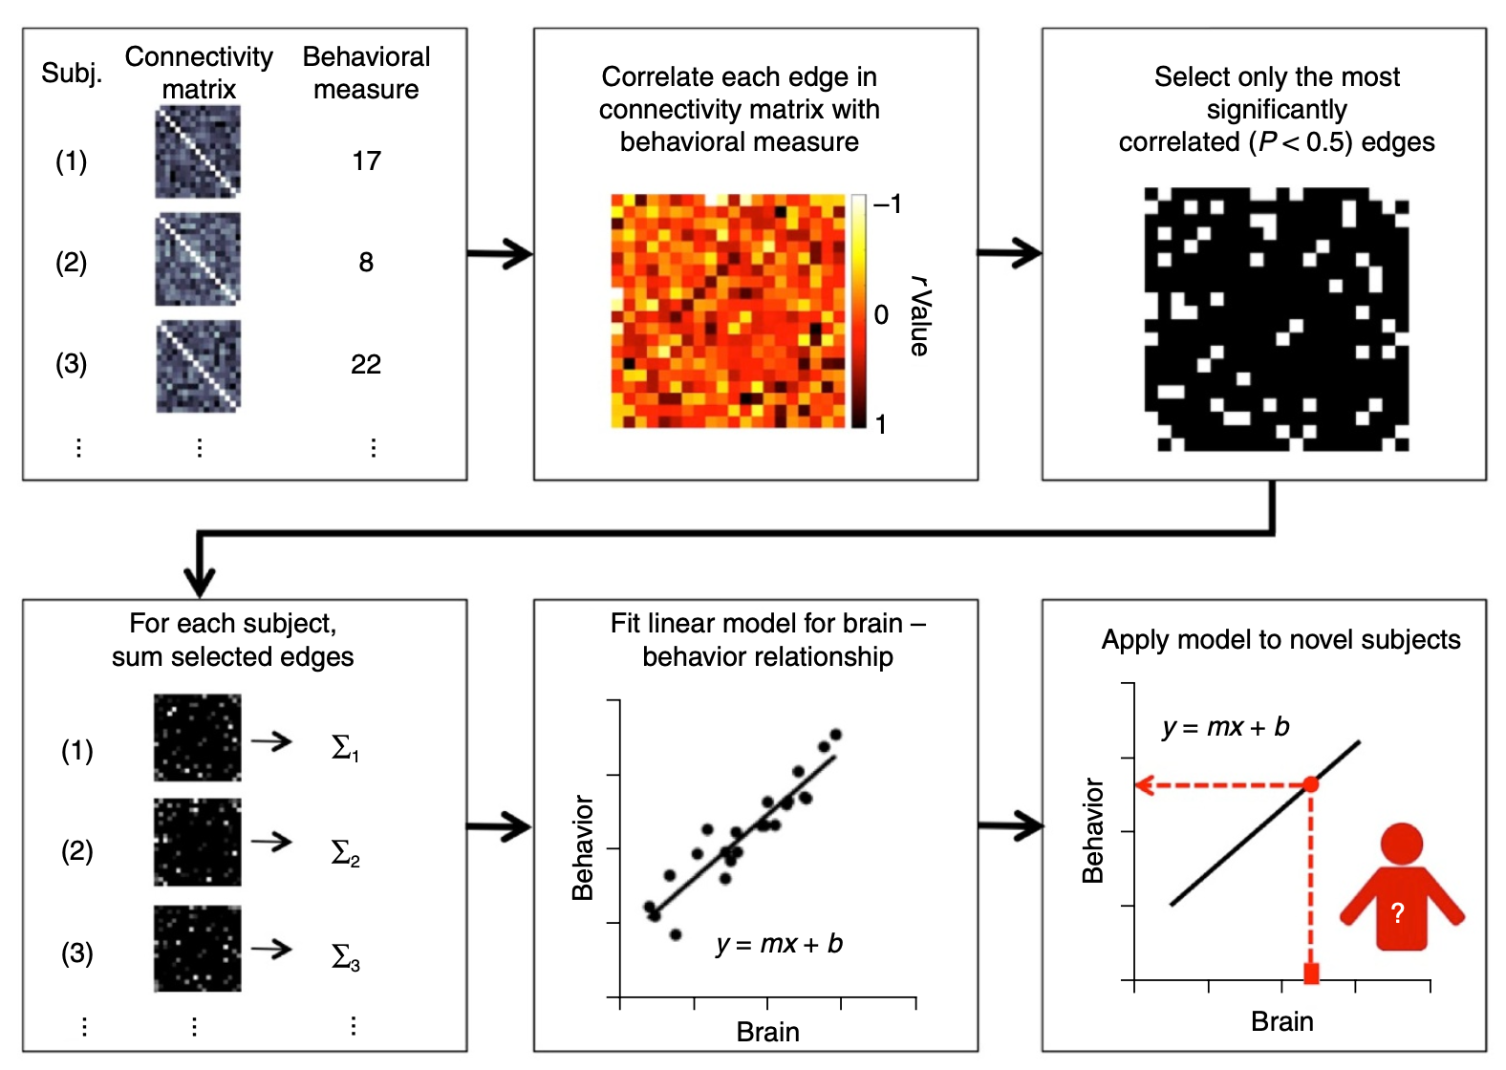
Study1: the relationship between multiple tasks and mathematics performance
CPM : lm1 (268 ROIs level)
feature selection
(ii) feature summarization
(iii) model building
(iv) assessment of prediction significance.
Shen, X., Finn, E., Scheinost, D. et al. Using connectome-based predictive modeling to predict individual behavior from brain connectivity. Nat Protoc 12, 506–518 (2017).
Notes:
For study 1, we investgate the relationship between multiple tasks and mathematics performance. our model are under the framework of CPM, which is a protocol form nature, it involves 4 steps.
We first reproduced their code and used it on our dataset, then made some adjustments based on the characteristics of our data.

Slide 14
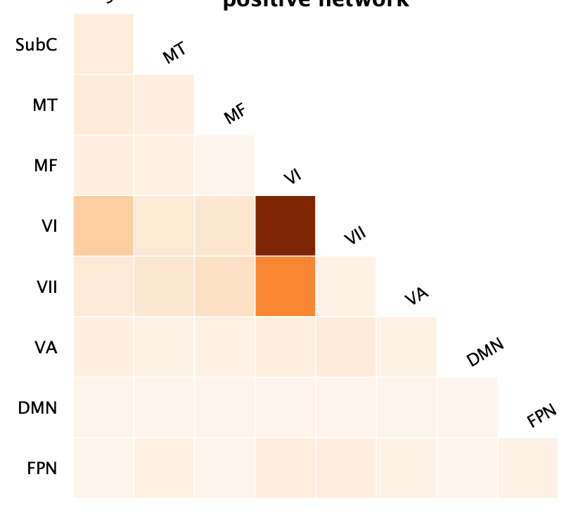
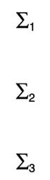
CPM: lm2
4 tasks:
randomly grouped n times, k-fold cross validation
PLS to associate each edge with the behavioral measure
First principal component loadings to Extract top 10% edges
Model | Task | Description | R-square | MSE
Lm1 | N-back task | Working memory | 0.0270 | 10039.25
 | Attention Network Test | Attention ability | 0.0203 | 10045.28
 | Balloon Analogue Risk Task | Risk decision-making | 0.0199 | 10170.10
 | Emotion Face Matching task | Emotion recognition | 0.0047 | 10233.37
Lm2 | N-back task *** | Working memory | 0.4944 | 5237.01
 | Attention Network Test *** | Attention ability | 0.4826 | 5248.34
 | Balloon Analogue Risk Task *** | Risk decision-making | 0.4941 | 5269.26
 | Emotion Face Matching task** | Emotion recognition | 0.4178 | 6008.52
4 tasks overlap
For each subject, sum the positive and negative selected edges respectively
neg
pos
*** represent coefficients p<0.01 **p<0.05
Y = beta1*neg+beta2*pos+age+gender+b
result1
When considering the four tasks separately, we reject H0, so both negative and positive FC of each task is associated with math performance, math learning is related to these 4 tasks.
The adjusted model(lm2) performs better, so our subsequent analysis is based on PLS.
Notes:
When we fit our model according to the original CPM, we found that the results were not so ideal. You can see that the r square is very low。
Considering our data, we have about 35,000 features, but we only have 3 hundreds subjects. For this kind of high-dimensional data, we may improve the effect by conducting dimension reduction. So we use PLS instead of ols.
In addition, based on experience, The positive and negative edge have different effects on the performance, so we add them up separately. At the same time, we control the influence of age and gender to obtain our final model. As we can see, our model performs better than the original one.
We got our first results:

Slide 15
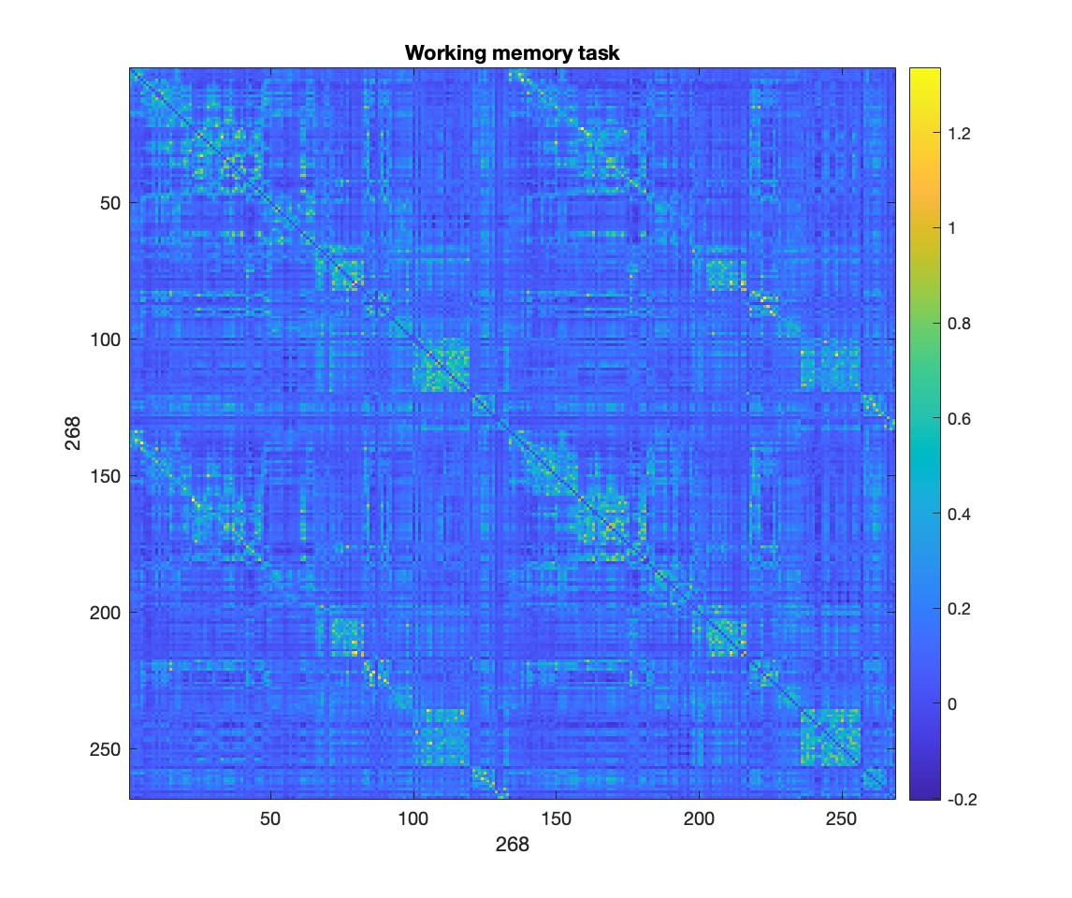
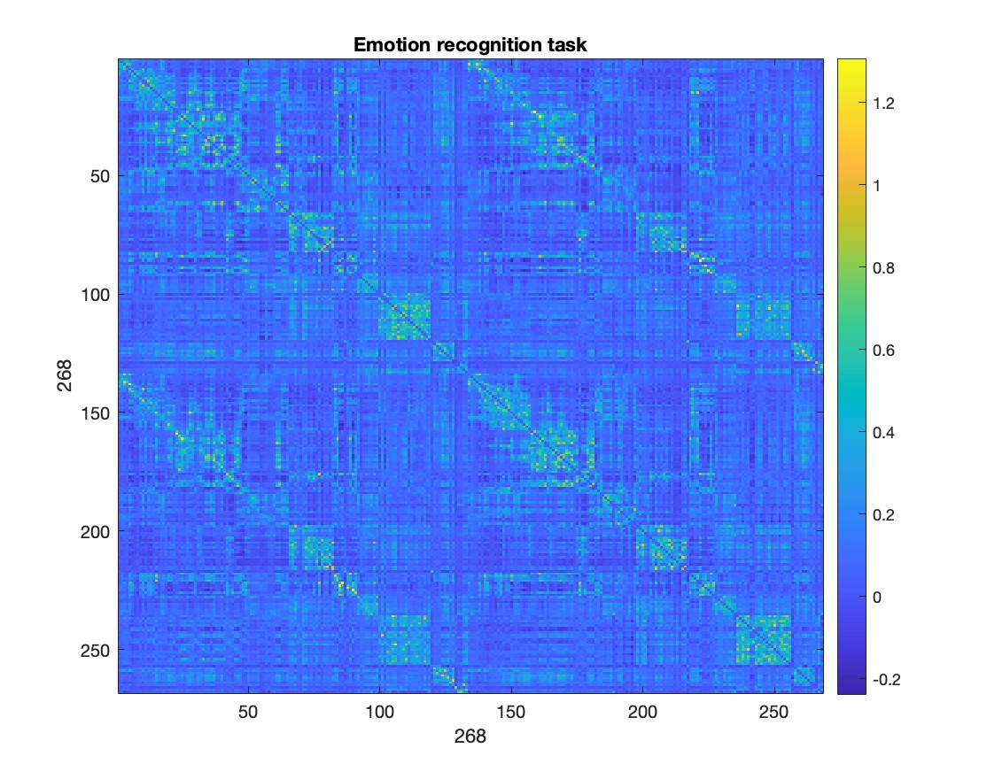
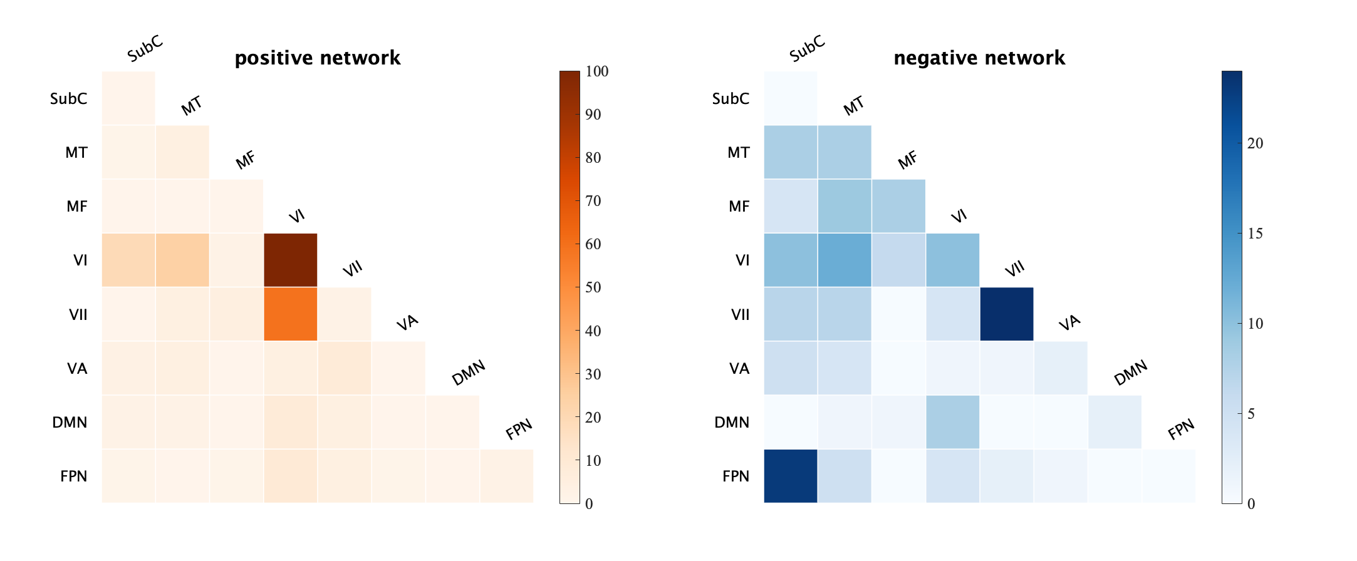
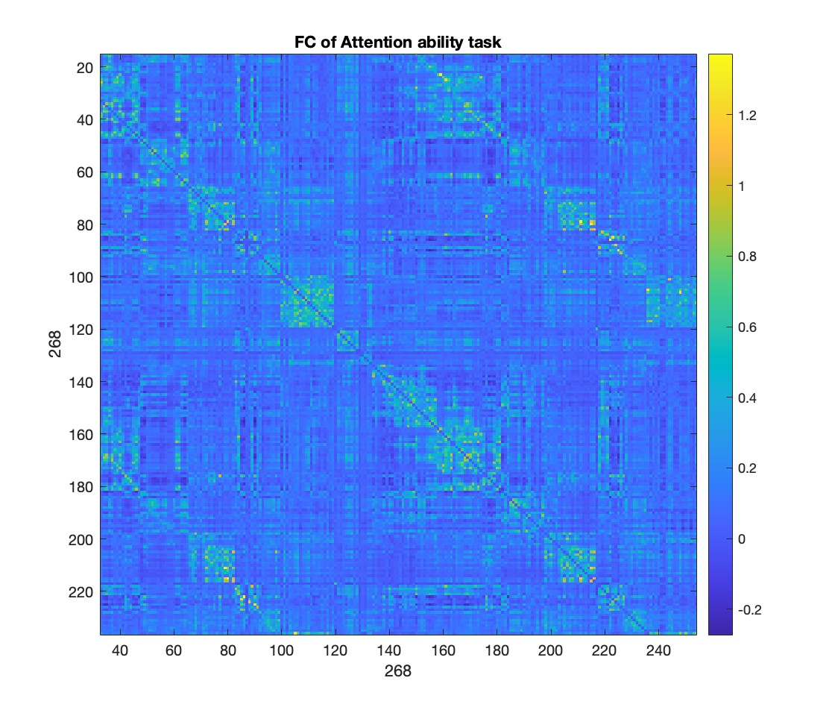
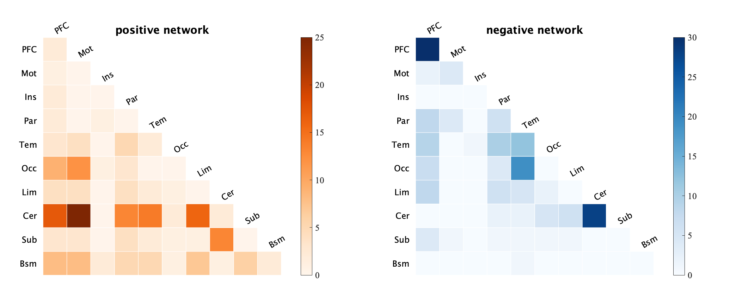
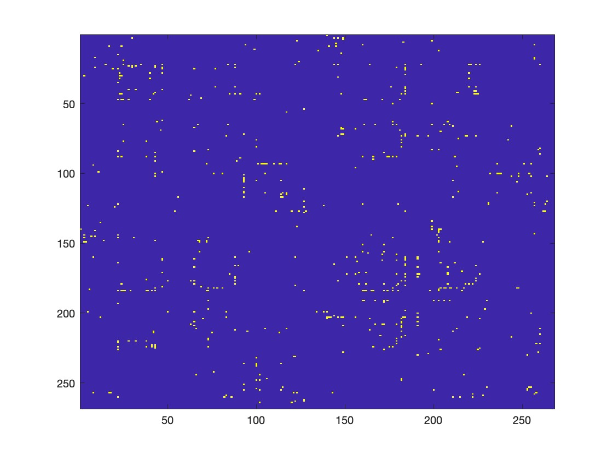
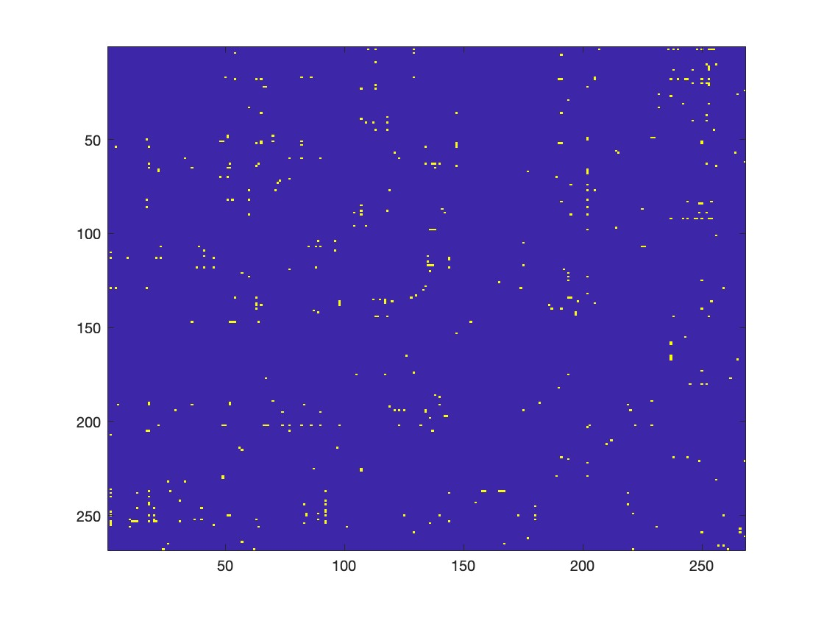
Networks associated with math performance
Canonical mask
Macroscale mask
Result2
Networks that associated with math academic performance are most located in multiple-demand system, which can be further allocated to the fronto-parietal network (FPN), Prefrontal cortex(PFC) and cerebellum(Cer).
Notes:
Next, let’s look at the common networks for these four tasks. We can see that the overlap in the four tasks is concentrated in the multi-demand system. which can be further allocated to the fronto-parietal network (FPN), Prefrontal cortex(PFC) and cerebellum(Cer).
The above are the results of the four tasks separately, which is the linear model. Next, Guo Rui will introduce how to combine the four tasks from the perspective of machine learning models.

Slide 16
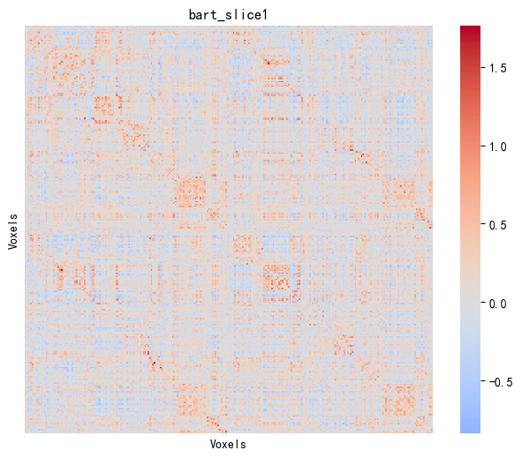
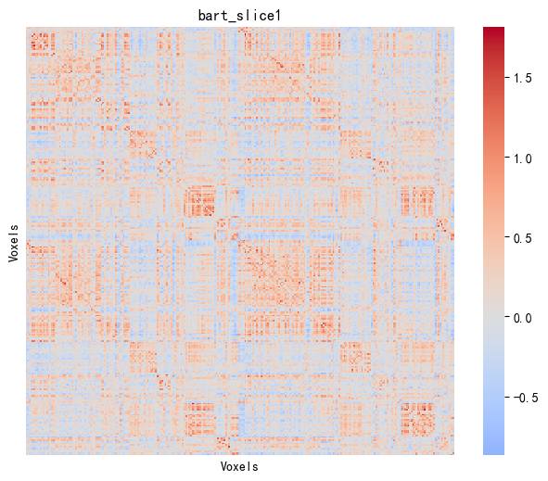
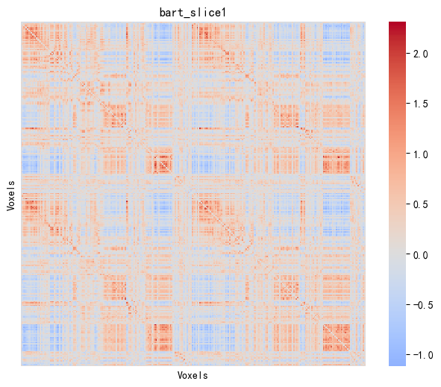
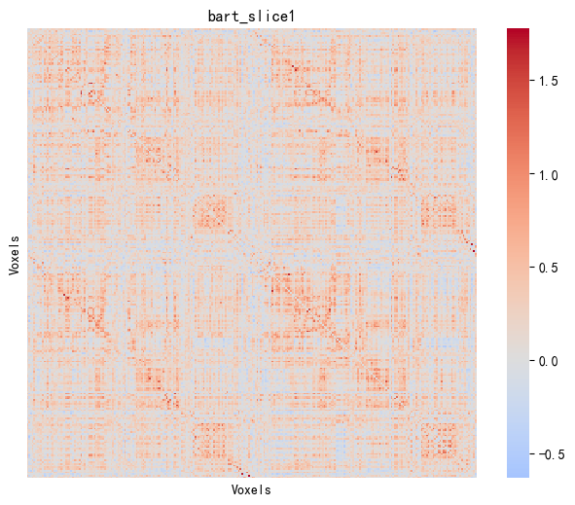
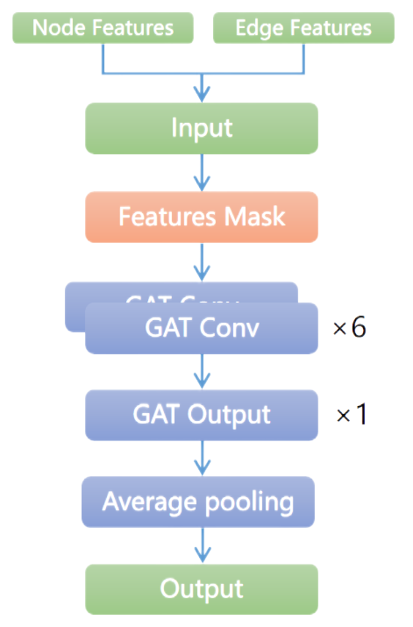
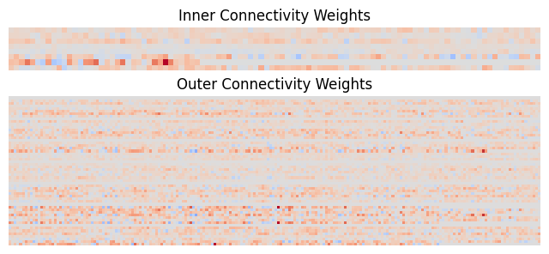
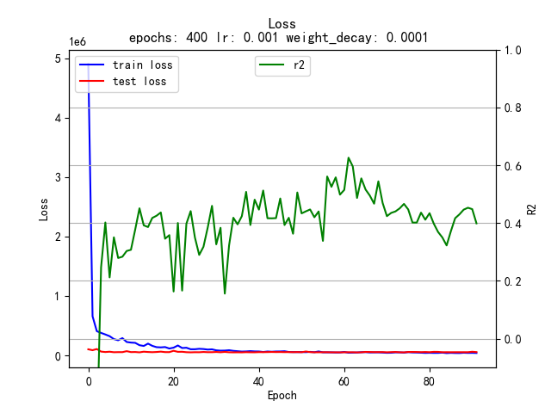
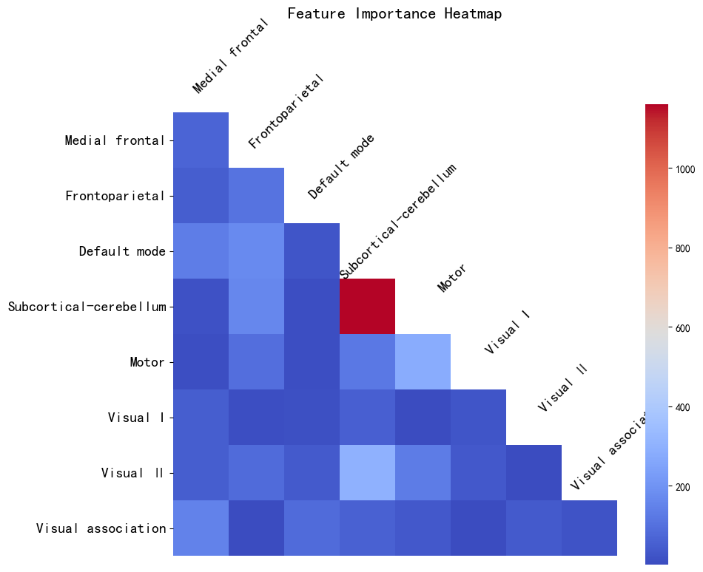
A. Data Integration and Feature Engineering
B. GAT Construction
FC Matrices
Tasks
Merging instances to improve data diversity
N-back Task
Merge 4 tasks datasets based on instance
Then split into:
Inner sub-feature sets
Outer sub-feature sets
GAT model
Train PLS on each sub-feature set and obtain the weight (loading of PLS) of each ROI
...
Attention Network Test
...
Balloon Analogue Risk Task
...
Emotion Face Matching Task
...
D. Biological basic interpretation
C. Model Tuning & Training
Mapping to networks
Top 10%
ROIs

Slide 17
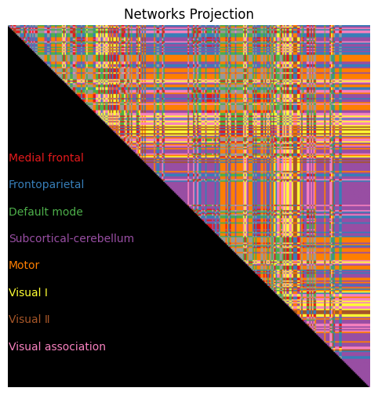
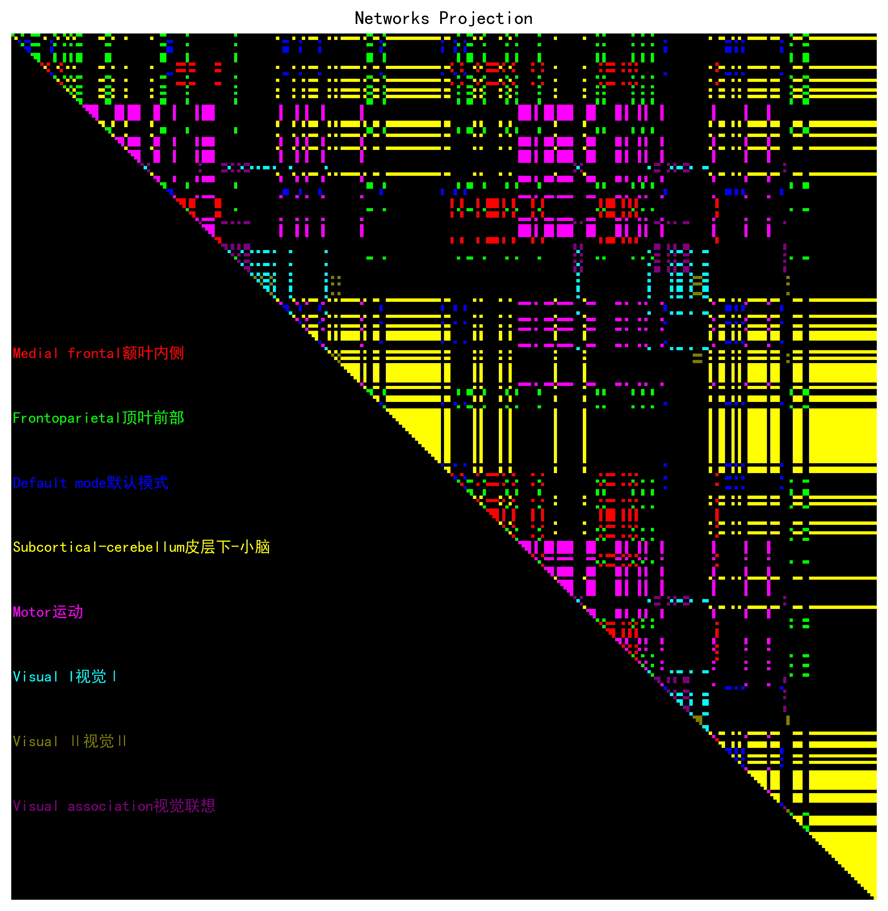
CPM: GAT Model based on networks(8*8)
FC Matrices
Tasks
Merging instances to improve data diversity
Avoid interference between features of different brain regions
N-back Task
...
Inner sub-feature sets: Extract FC between ROIs within each network (8 sub-feature sets).
Outer sub-feature sets: Extract FC between ROIs across all networks pairs(56 sub-feature sets).
This results in a total of 64 sub-feature sets
Attention Network Test
Merge 4 tasks datasets based on instance
...
Balloon Analogue Risk Task
...
Emotion Face Matching Task
...
Inner&Outer Connectivity Groups
Train PLS on each sub-feature set and obtain the weight of each node feature
A try
Stacking model: use PLS’s output as input of elastic regression. However, the performance is poor (specifically, the R² is only 0.16)---didn’t combine inner and outer information
Weight each sub-feature using PLS’s loading
How toutilize all sub features?(both inner and outer information)
GAT Model
Notes:
Thanks to Yang Tongxi for sharing.
非线性模型引入
Considering that the PLS model can only capture linear correlations in features, we have chosen to introduce a non-linear model to capture non-linear features in the functional connectivity matrices.
数据合并
To enhance data diversity and allow the model to capture unique features from four sets of data, we also choose to merge 4 tasks datasets based on instance.
特征切分
Moreover, to prevent interference between features, we extract the FC within each network's regions of interest (ROIs) as separating sub-feature sets, termed 'Inner sub-feature sets'; similarly, we extract the FC between regions of interest (ROIs) of different network pairs, termed 'Outer sub-feature sets’.
PLS独立训练
Then, we fit PLS on each sub-feature set separately and attempt to train a stacking model with an elastic-net regression model as the meta-model and PLS as the base model. However, we got a poor result. It is evident that we haven’t effectively utilized the internal and external connectivity features of the network.
下一步介绍
Therefore, we selected the Graph Attention Network model, which can combine the internal and external connectivity features and also capture non-linear and deep-level feature information. Additionally, we use PLS's loadings to weight features to highlight important features.

Slide 18
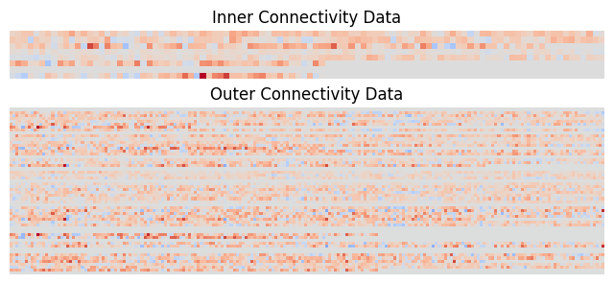
CPM: GAT Model
Idea:
GAT Model.
Treat each network as a node in the GAT, with inner sub-features as node features.
Treat the connections between networks as edges, with outer sub-features as edge features.
Weighted train&test datasets
Graph Attention Network
loss curve and R² curve
Node Features
Edge Features
Input
Hyperparameters
Epochs | 70
Batch_size | 32
Optimizer | lr | 0.001
 | weight_decay | 1e-4
 | lr_scheduler | mode | min
 |  | factor | 0.5
 |  | patience | 20
Metrics | R² & MSE
Early_stop | 70
Features Mask
heads=8
dropout=0.5
concat=True
negative_slope=0.2
add_self_loops=True
bias=True
residual=True
GAT Conv
×6
GAT Conv
GAT Output
×1
heads=1
dropout=0.2
concat=False
negative_slope=0.2
add_self_loops=True
bias=True
residual=True
Extract the top 10% important features and find their corresponding networks using the Features Mask
Average pooling
Output
Notes:
方法介绍
Our approach is as follows:
Treat each network as a node in the GAT, with inner sub-features serving as node features, and take the connections between networks as edges, with outer sub-features acting as edge features.
参数调优
After lots of structural comparison and hyperparameter tuning, we have determined the optimal model structure and hyperparameters as shown in the slide.
特征掩码
Specifically, we employ a trainable Feature Mask to capture the importance of input features.
During training, these parameters are updated based on the gradients of the loss function. The model learns which features are more important (with values close to 1) and which are less important (with values close to 0). These masks are often combined with regularization to encourage the model to push unimportant feature mask values towards 0, achieving a sparse representation of features.
效果
Upon training, the model achieved a better performance. Then we extracted the top 10% of important features using the Feature Mask and identified the networks where these features are most likely located.

Slide 19
Networks associated with math performance
Model | Task | Description | R-square | MSE
Lm1 | N-back task | Working memory | 0.0270 | 10039.25
 | Attention Network Test | Attention ability | 0.0203 | 10045.28
 | Balloon Analogue Risk Task | Risk decision-making | 0.0199 | 10170.10
 | Emotion Face Matching task | Emotion recognition | 0.0047 | 10233.37
Lm2 | N-back task *** | Working memory | 0.4944 | 5237.01
 | Attention Network Test *** | Attention ability | 0.4826 | 5248.34
 | Balloon Analogue Risk Task *** | Risk decision-making | 0.4941 | 5269.26
 | Emotion Face Matching task** | Emotion recognition | 0.4178 | 6008.52
GAT | Merged Tasks | Merged Tasks Data | 0.6259 | 4461.43
Result 3
Networks associated with math academic performance are primarily located in the multiple-demand system. These networks are mainly allocated to the cerebellum and secondarily to the connectivity between the cerebellum and Visual II, which is consistent with our previous results.
Our results imply that considering all tasks together may better than just a single task.
Notes:
结果
Compared to the linear PLS model mentioned before, the GAT model demonstrated better performance on this task.
After feature extraction and mapping to the networks, we obtained the following results:
The networks associated with mathematic academic performance are primarily located in the multiple-demand system. These networks are most likely allocated to the cerebellum and, secondarily, to the connectivity between the cerebellum and Visual II, which aligns with our previous findings.
Besides, our findings suggest that considering all tasks together may be more beneficial than focusing on a single task alone.
下一部分引入
Next, let Sun Yixuan introduce some differences in the multi-demand networks based on our previous studies.

Slide 20
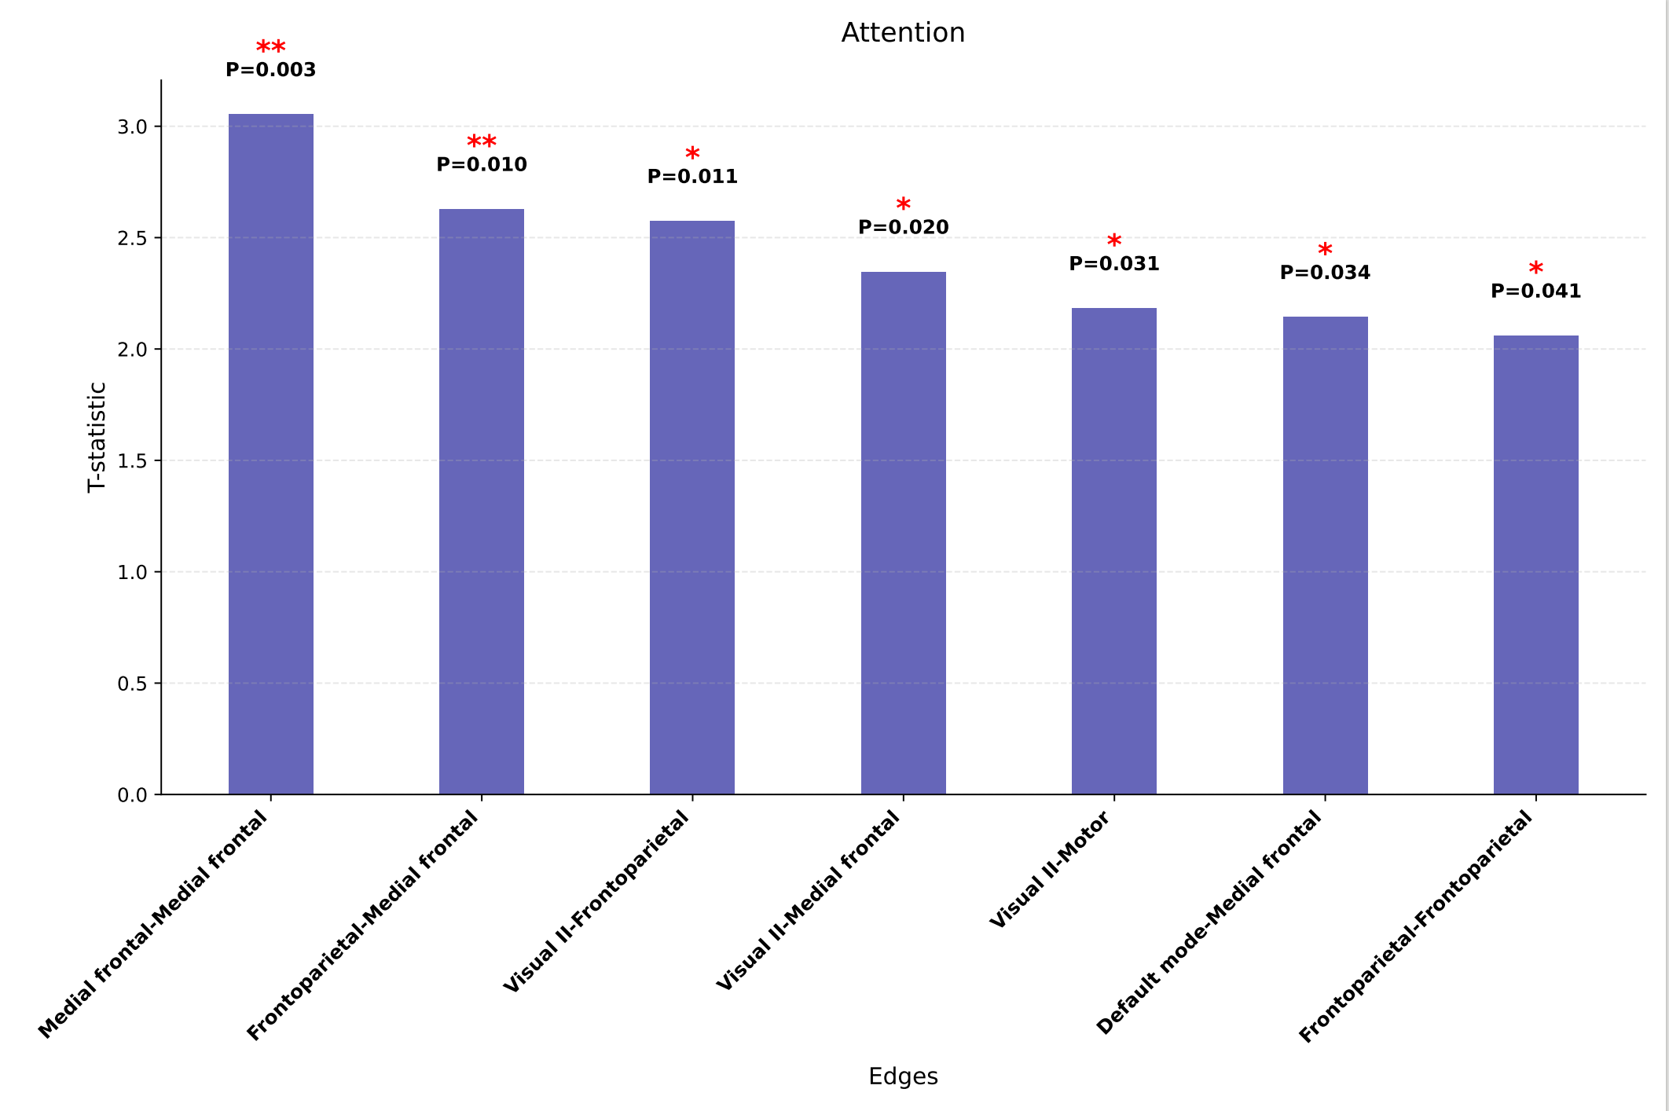
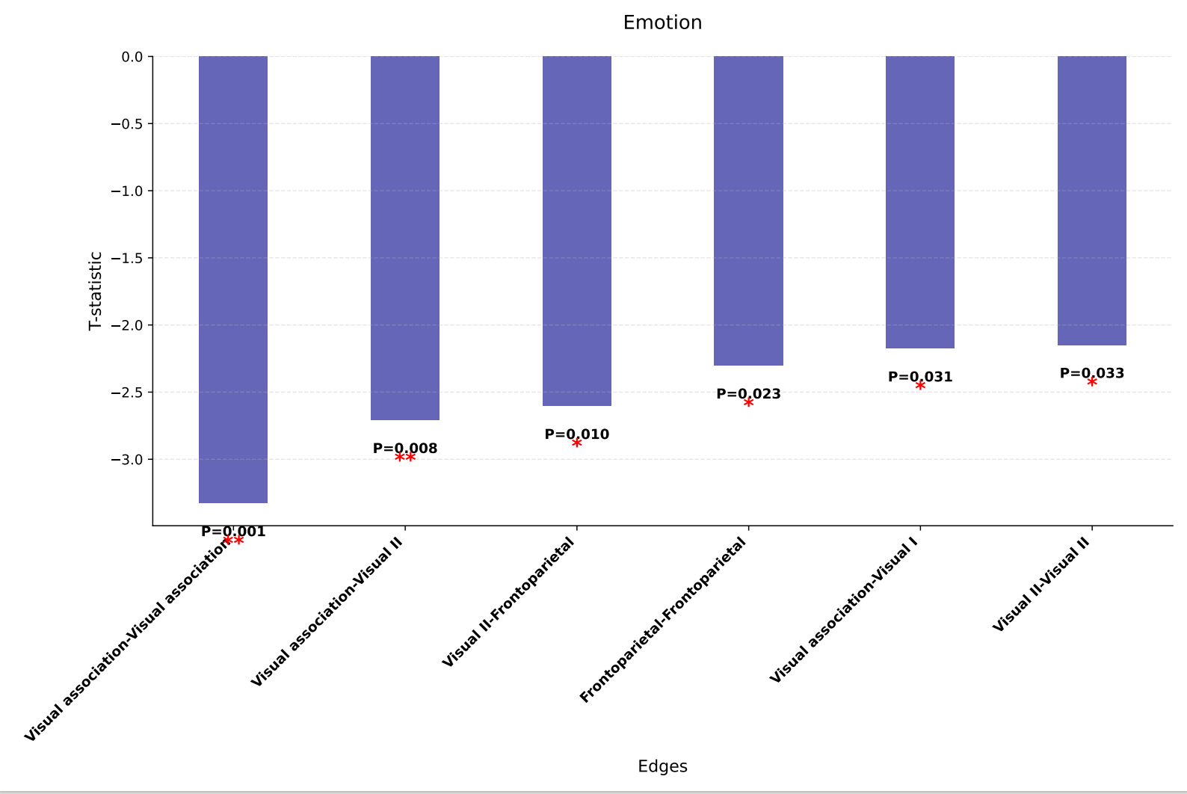
Study2: differences in the multi-demand networks
T-test: Differences in 8 networks between good and bad math students
result4
Specifically, in the attention task, the differences in Medial frontal-Medial frontal, Frontoparietal-Medial frontal(FPN) are significant, which are located in the multi-demand networks.
In other tasks, we didn’t find differences in multi-demand networks.
Notes:
Next, let’s explain the solution of study 2. To explore the individual differences in multi-demand networks, In our study, we employed quartile analysis to categorize participants. Similarly, their fc_matrix is converted into networks, and a t-test is performed on the high and low groups.As shown in the figure，。。。。。。

Slide 21
Study2: Connection density
Identify differences in overall network characteristics
Overall connection strength
Adaptive Threshold Method
Binarization
Connection density
 | T-statistic | P-value | Significant
Emotion | -2.3956 | 0.0178 | FALSE
Attention | 0.6148 | 0.5398 | FALSE
Working memory | -0.4048 | 0.6862 | FALSE
Risk decision-making | -1.4718 | 0.1431 | FALSE
result 5
There is no significant difference in the density of brain connections.
Bullmore, E., & Sporns, O. (2009). Complex brain networks: graph theoretical analysis of structural and functional systems. Nature Reviews Neuroscience, 10(3), 186-198.
Notes:
In order to explore whether there are significant differences in overall brain connectivity between high and low groups, we refer to the paper below and choose connection density as an indicator，which can represent the information transmission and functional integration capabilities of the brain. As the result, we could not identify differences in connectivity across the whole brain, but we could in the multi-demand network, which means the multi-demand network is associated with mathematical learning.

Slide 22
Summary:
Q1: How to improve math scores by not just doing exercises?
Study1: the relationship between multiple tasks and mathematics performance
Our results show that considering all tasks together may better than just a single task.
Suggestion:
By completing the four tasks, we can identify students’ deficiencies in certain abilities, which leads to poor math performance. Based on this, the education department can provide targeted training on the specific task.
Q2:Do brain networks differ between people with high and lower math scores?
Study1 and Study2: differences in the multi-demand networks
Our results show that networks that associated with math academic performance are most located in multiple-demand system, and specifically, attention task is characterized by significant variability in FC of multi-demand networks.
Suggestion:
Students can develop an objective understanding of their own abilities and, in conjunction with their interests, choose appropriate developmental pathways.
Notes:
Finally, let's review what we have done. First, let's look at the first question: In addition to relying on doing exercises, how should we improve math scores? Based on the relationship between multi-tasks and math performance, we believe that a comprehensive approach that considers all tasks may be more effective than focusing on a single task. So we suggest that //by completing four different types of task assessments, we can identify students' deficiencies in certain abilities that may lead to poor math scores. Education departments also can provide targeted training for students based on this and focus on improving their performance on specific tasks.
Next, let's look at the second question: Are there differences in neural networks between students with good and poor math scores? The conclusion is that we found that the neural networks related to math learning performance are mainly located in the multiple demand system. It is worth to note that in attention task, the functional connectivity of the multiple demand network showed significant variability. Based on these findings, we suggest that students can use these objective assessments to understand their own ability characteristics, then they can combine their personal interests, and choose the development path that best suits them.
We believe that these research findings can not only help better understand the neural mechanisms of math learning, but also provide important guidance for educational practice. By understanding and applying these research results, we can help students improve their math scores more effectively.

Slide 23
03.
Discussion
Notes:
Last part,discussion

Slide 24
Highlight， Limitations and Future work
Highlight
Theoretically:
Our study identities a set of FC within multi-demand network that precisely represents mathematical cognition.
The multi-demand network demonstrate the relationship between cognitive function, such as attention, emotion, working memory, risk decision-making with mathematical learning.
Practically:
Our research provides concrete suggestions for mathematics learning and education.
We change the model framework according to the characteristics of our data, and our model has interpretability.
Limitations and Future work
From static to dynamic
Our research on brain activity patterns is limited to static functional connectivity. However, the brain is a dynamic system, We can more accurately understand the working mechanism of the multi-demand brain network from a dynamic perspective.
From single test to graph theory
Our research on the differences in brain networks between those with good and poor math performance is still preliminary. We may consider adding more graph theory to further analyze.
Notes:
this is the highlight, limitations of our research, and some future work we may explore.

Slide 25
Any questions or suggestions about our research?
We really value your suggestions！

Slide 26
Thank you for your attention!
We wish we can find our own strengths and apply them to our world.
And we will find happiness in anything we would like to pursue-now and the future!

